Slide 1
NLSR Sync

Slide 2
What's New
LSDBs are note synchronized by the routing agents anymore, instead the Sync Protocol is used to advertise the Link and Named LSAs and for keeping LSDBs in sync
Consequently, the naming structure for the Interests has been changed as well
Keep Alive (Info) Interests are still required to check the status of the routing agents
A mechanism to detect the status of the local repo is also required
As delete operation is not supported by the repos, so we still need the local storage to keep only the valid routes
No need to specify the faces for named LSAs in the configuration file of the routing agent

Slide 3
Tasks for the Routing Agent
Routing agent will have the following responsibilities
Creating slice
Creating LSAs and passing it to the repo
Maintaining internal data structure by deleting the stale routes and adding the new one
Calculating the shortest paths and adding them to the FIB
Checking whether remote routing agents and local repo are alive or not

Slide 4
Interaction of Components
Castor
Pollux
NLSR
NLSR
Repo/Sync
CCND
CCND
Repo/Sync
Tunnel

Slide 5
Initial Setup
Start CCND,
Create conf for the repo and run ‘ccnr’ make sure that:
global prefix is unique, for e.g.: /<router id>/repo
Although Sync is enabled by default, just make sure it is not turned off
Create topo and slice prefixes, can be done on command line or through the agent
Topo prefix: /ndn/routing/nlsr/
Slice prefix: /ndn/routing/nlsr/LSAs/
As the topo prefix should be routable, create routes for it
Set a routable prefix for the Info interest
The Info interest uses the same prefix structure used for nlsr-0.0

Slide 6
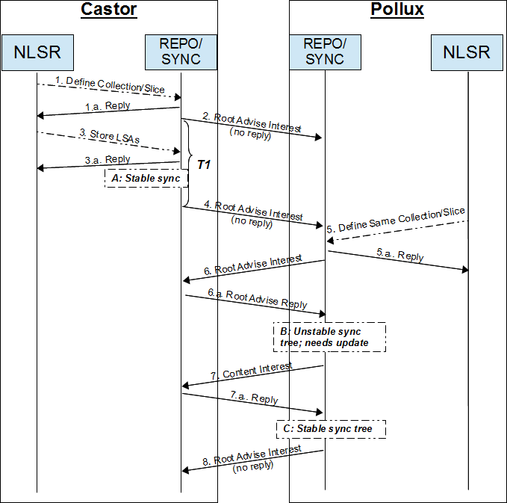
Basic Workflow
Define collection or slice on name prefix:
/ndn/routing/nlsr/LSAs/
Root Advise Interest is sent by Castor’s Sync to check the state of the remote Sync
NLSR stores some LSAs to Repo
A: A new sync tree is built
The Root Advise Interest is sent again periodically after every T1 seconds
Pollux creates a slice using the same slice and topo prefix that is given in 1
Root Advise is sent from the Pollux to Castor
B: The root hash of Pollux’s sync is different than the Castor’s sync.
Send the Interest for the contents that are not in the Pollux’s sync tree
Receives Reply and stabilizes the tree
Pollux sends a final Root Advise Interest to disseminate local changes (in this e.g., the two Repositories have the same contents for the Collection, so Castor does not reply).

Slide 7
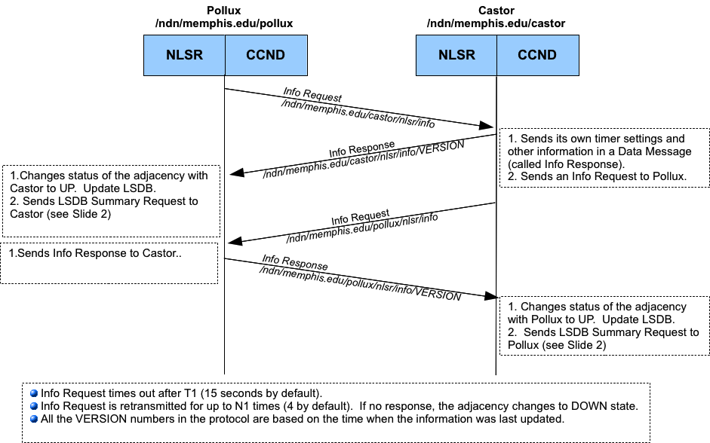
Detecting Failures
NLSR failures can be detected using Info Interest
As shown in figure
Repo failures can be detected by listening on the topo or global prefix
ccnseqwriter or ccnsyncwatch does the same

Slide 8
Getting Face IDs from Names
As the ‘notice.txt’ method discussed in the meeting doesn’t serve the purpose, we need to write our own method for it
ccndstatus (ccnsmoketest status), provides some hints for that

